Slide 1
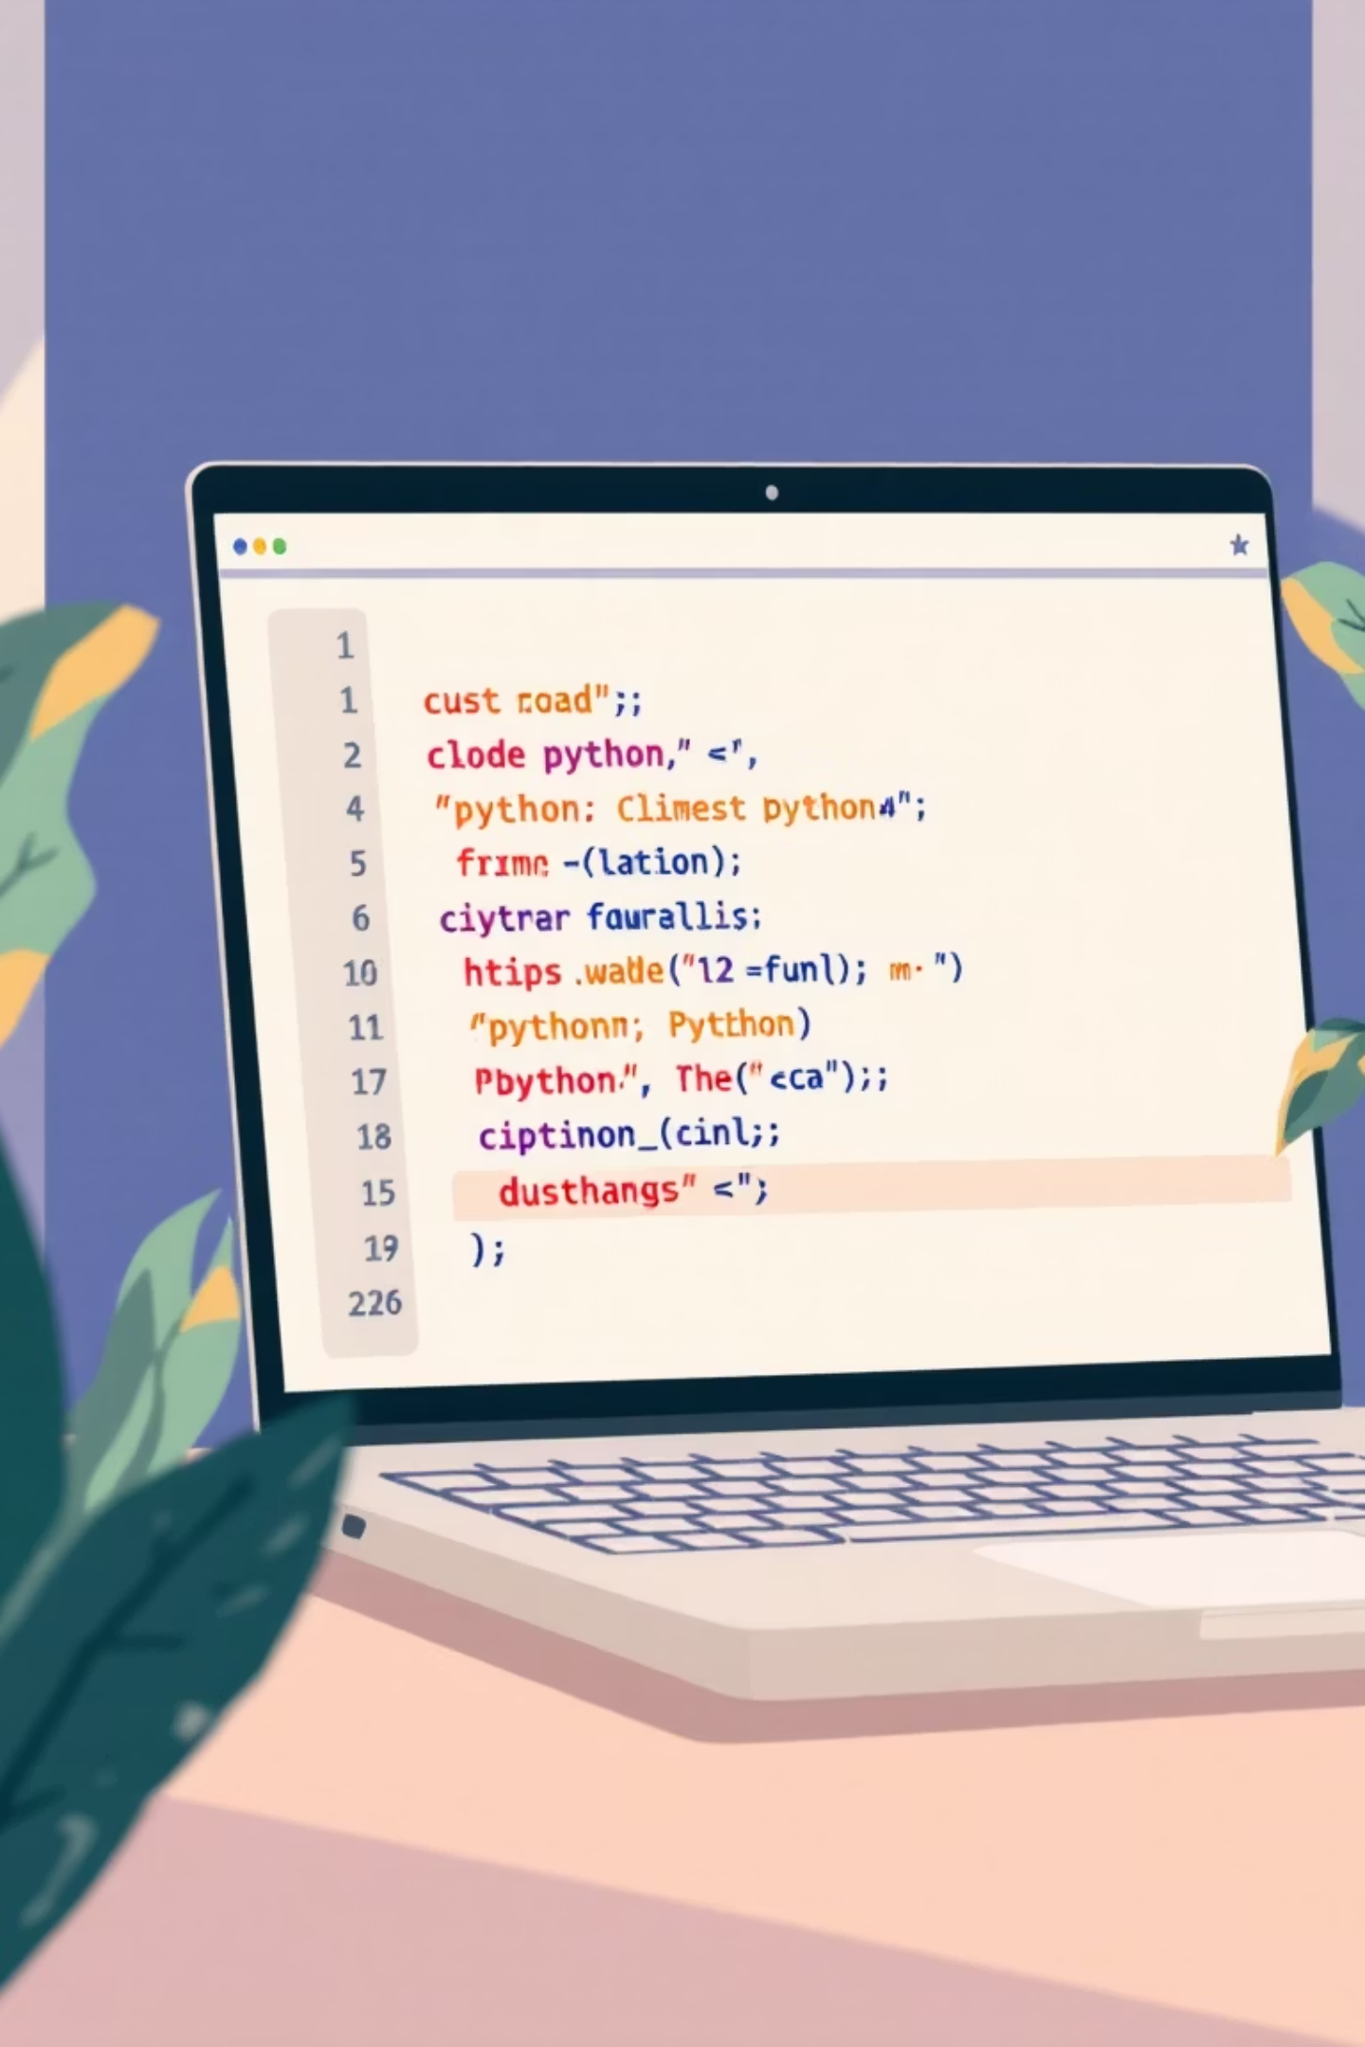
Introduction to Python: Your First Step into Programming
Welcome to the exciting world of Python programming. Whether you're a complete beginner or exploring a new language, Python offers an accessible and powerful gateway to coding mastery.

Slide 2
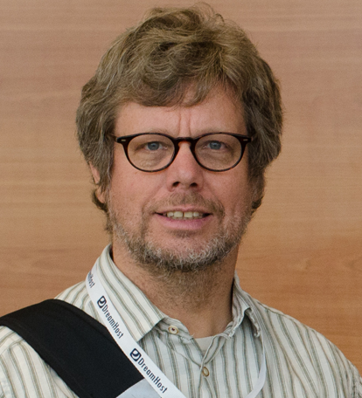
What is Python?
Python is a high-level, interpreted programming language created by Guido van Rossum in 1991. Designed with philosophy emphasizing code readability, it uses significant indentation and clean syntax.
Known for its simple, readable syntax that resembles natural English, making it one of the most approachable languages for beginners while remaining powerful enough for expert developers.
Python is widely used across diverse domains including web development, data science, artificial intelligence, automation, scientific computing, and game development.

Slide 3




Why Use Python?
Beginner-Friendly
Rich Ecosystem
Easy to learn for newcomers with intuitive syntax, yet powerful enough for experts building complex applications.
Extensive libraries and frameworks including Django for web, NumPy for science, TensorFlow for AI, and thousands more.
Cross-Platform
Strong Community
Runs seamlessly on Windows, macOS, and Linux without requiring code changes or modifications.
Millions of developers worldwide provide support, tutorials, documentation, and open-source contributions.

Slide 4

The Importance of Python Today
#1
100M+
3
Programming Language
Lines of Code
Key Fields
Consistently ranked as one of the top programming languages globally on indices like TIOBE and Stack Overflow.
Powers major tech giants including Google, Instagram, Spotify, Netflix, and NASA's space missions.
Essential language in emerging domains: machine learning, data analysis, and intelligent automation systems.
50%
Faster Development
Enables rapid prototyping and development cycles, significantly saving time and organizational resources.

Slide 5
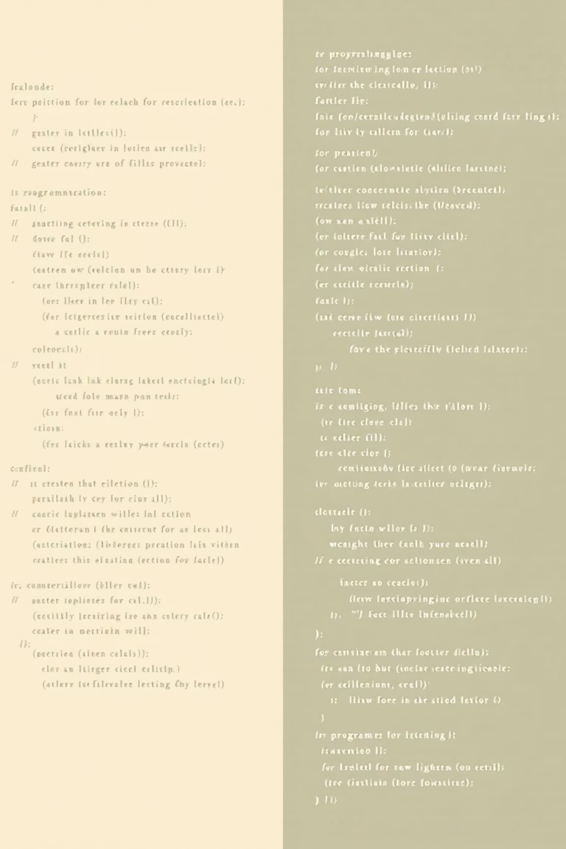
Python vs Other Programming Languages
Python Advantages
Trade-offs
Shorter, cleaner code compared to Java or C++
Slower execution speed than compiled languages
No manual memory management required
Not ideal for system-level programming
Simple, readable syntax that's easy to understand
Higher memory consumption in some cases
Faster development cycles and prototyping
Less suitable for mobile app development
Ideal for scripting, automation, and data tasks

Slide 6

How to Write Your First Python Program
01
02
Install Python
Choose VS Code
Download Python from python.org and run the installer. Make sure to check "Add Python to PATH" during installation for easy command-line access.
Download Visual Studio Code from code.visualstudio.com. It's a free, powerful code editor with excellent Python support and debugging capabilities.
03
04
Install Python Extension
Create Your File
Open VS Code, click the Extensions icon, search for "Python" by Microsoft, and install it for syntax highlighting, IntelliSense, and debugging features.
Create a new file with a .py extension (e.g., hello.py). This tells your system and editor that the file contains Python code.

Slide 7
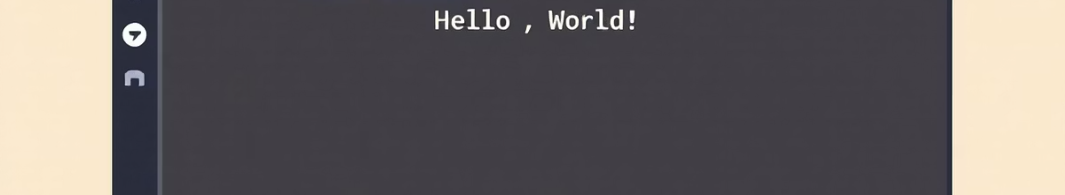
Coding "Hello World" in Visual Studio Code
Step-by-Step Process
# Your first Python program print("Hello, World!") # Output: # Hello, World!
Open VS Code and create a file named hello.py
Type the code: print("Hello, World!")
Save the file using Ctrl+S (Windows) or Cmd+S (Mac)
Open the integrated terminal (View → Terminal)
Type: python hello.py and press Enter
See the output: Hello, World!

Slide 8
Full Details: Your First Python Program Explained
The print() Function
String Literals
print() is a built-in Python function that outputs text or data to the screen. It's one of the most commonly used functions for displaying results and debugging code.
Text inside quotes "Hello, World!" is called a string literal. Strings can use single quotes ('text') or double quotes ("text") interchangeably in Python.
Line-by-Line Execution
Simple Syntax Advantage
Python executes code sequentially, line by line, interpreting commands immediately. This interpreted nature allows for rapid testing and immediate feedback during development.
This simple program perfectly demonstrates Python's straightforward syntax philosophy: readable code that does exactly what it says without complex boilerplate or ceremony.

Slide 9
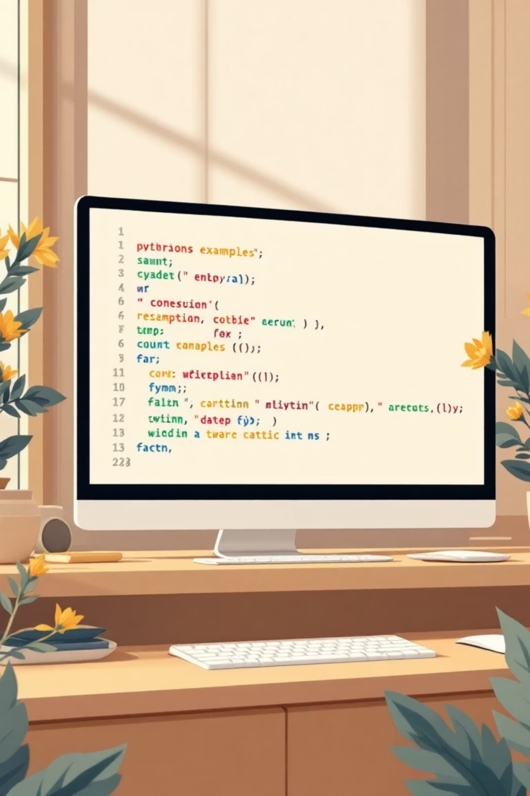
More Python Code Examples
Variables and Data Types
Lists and Loops
# Variables store data name = "Alice" age = 25 height = 5.6 is_student = True print(name) print(age)
# Working with lists fruits = ["apple", "banana", "orange"] for fruit in fruits: print(fruit)
Conditional Statements
# Making decisions temperature = 75 if temperature > 80: print("It's hot!") elif temperature > 60: print("It's nice!") else: print("It's cold!")
Simple Math Operations
# Basic calculations x = 10 y = 3 print(x + y) # Addition: 13 print(x * y) # Multiplication: 30 print(x / y) # Division: 3.33

